Slide 1
The Birthday Problem
When Intuition Fails Us

Slide 2
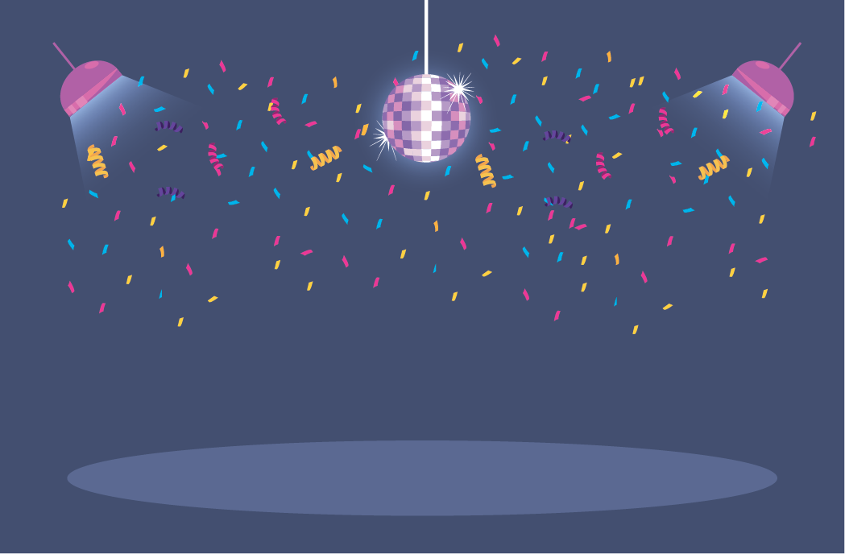
It’s A Party!!
Notes:
We are having a party

Slide 3
It’s A Party!!

Slide 4
It’s A Party!!

Slide 6
It’s A Party!!

Slide 7
Expectations?
Question
How many people will have to be at the party for us to have a greater than 50% chance of two people sharing the same birthday?
Assumptions
365 Days Per Year
Twins, seasonal & weekday variation ignored
366 People = 100% (Pigeonhole Principal)

Slide 8
Reality
# of People | 10 | 20 | 23 | 30 | 40 | 50 | 85
Match Prob. | 11.61% | 40.62% | 50.05% | 69.68% | 88.23% | 96.53% | 99.99%

Slide 9
Calculating the Probability
The probability of any two people not having the same birthday is 364/365. In a room containing n people, there are (^{n}₂) = n(n − 1)/2 pairs of people, i.e. (^{n}₂) events.
The probability of no two people sharing the same birthday can be approximated by assuming that these events are independent and hence by multiplying their probability together. In short 364/365 can be multiplied by itself (^{n}₂) times, which gives us
Since this is the probability of no one having the same birthday, then the probability of someone sharing a birthday is

